Slide 1
Jetpack Compose Navigation

Slide 2
Lesson 4 - Navigations

Slide 3
Intents

Slide 4
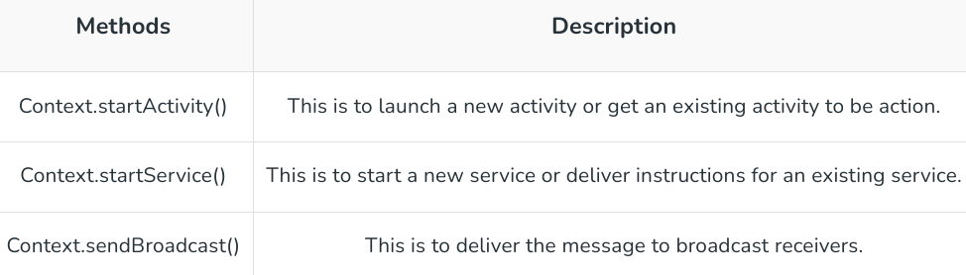
Intent and its types
An intent is an abstract description of an operation to be performedAn intent is an abstract description of an operation to be performed
It can be used with startActivity to launch an Activity, broadcast or service.
An Intent provides a facility for performing late runtime binding between the code in different applications
Its most significant use is in the launching of activities, where it can be thought of as the glue / bridge between activities

Slide 5
Intent Structure
The primary pieces of information in an intent are:
action -- The general action to be performed, such as ACTION_VIEW, ACTION_EDIT, ACTION_MAIN, etc.
data -- The data to operate on, such as a person record in the contacts database, expressed as a Uri.
Some examples of action/data pairs are:
ACTION_VIEW content://contacts/people/1 -- Display information about the person whose identifier is "1".
ACTION_DIAL content://contacts/people/1 -- Display the phone dialer with the person filled in.

Slide 6
Intent and its types (Contd...)
There are two types of intents
Explicit Intent
Where the destination component is explicitly defined, i-e notifying where or what we want to do specifically explaining the destination component.
Implicit Intent
When we don’t specify the destination component, instead provide enough information for the operating system to start the task based the provided information in the form of actions, data and categories.

Slide 7
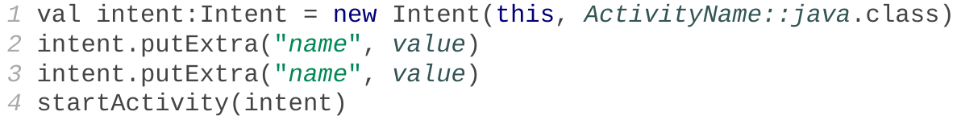
Explicit Intent
To launch another activity (usually in response to an event), create an Intent object and call startActivity with it:
If you need to pass any parameters or data to the second activity, call putExtra on the intent.

Slide 8
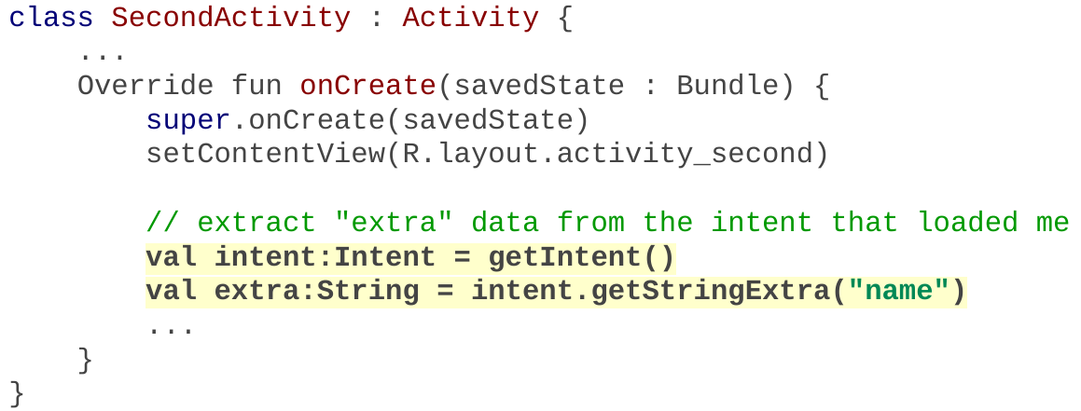
Extracting Data
In the second activity that was invoked, you can grab any extra data that was passed to it by the calling activity.
Access the Intent that spawned you by calling getIntent.
The Intent has methods like getIntExtra, getStringExtra, etc. to extract data that was stored inside the intent.

Slide 9
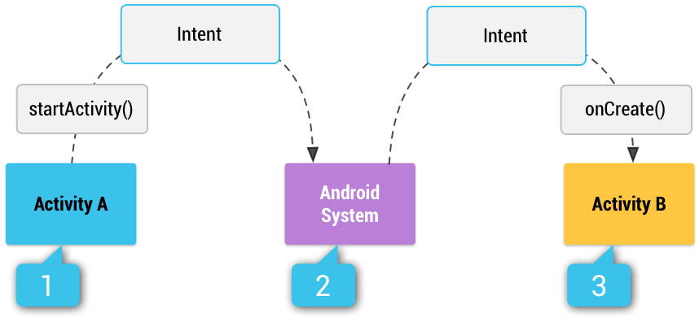
Implicit Intents
Implicit Intent doesn’t specify the component. In such a case, intent provides information on available components provided by the system that is to be invoked.
When you use an implicit intent, the Android system finds the appropriate component to start by comparing the contents of the intent to the intent filters declared in the manifest file of other apps on the device
If the intent matches an intent filter, the system starts that component and delivers it the Intent object
If multiple intent filters are compatible, the system displays a dialog so the user can pick which app to use.

Slide 10

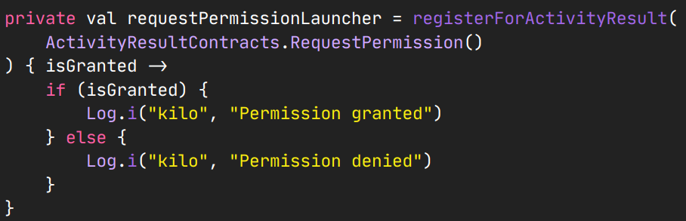
Implicit Intents – Camera Example
Implicit Intent usually are used to launch apps installed on device, so it requires permissions from user to be added in manifest as well as request them in code.
Lets take camera app as an example, first add the camera permission and hardware in manifest.xml
Next we also need to request the permission in code. For-Example, following code will create a launcher for permission.

Slide 11
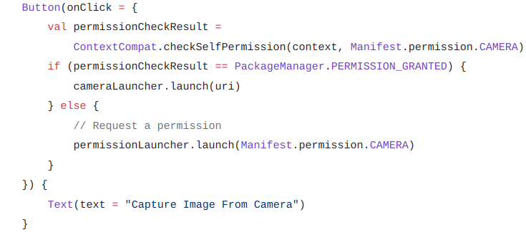
Implicit Intents – Camera Example
On Button click we can check whether the permission is granted or not, then either we can launch the camera app or we can request the permission using the launcher created perviously.
On Button click we can check whether the permission is granted or not, then either we can launch the camera app or we can request the permission using the launcher created perviously.

Slide 12
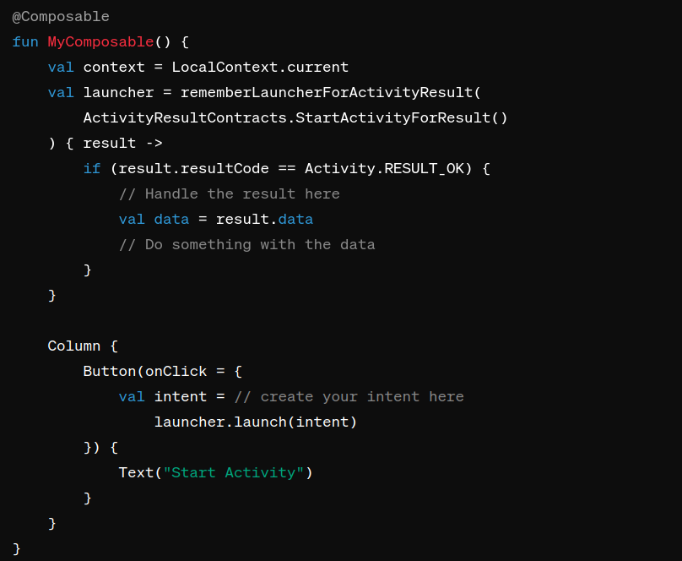
Implicit Intents – Camera Example
In Jetpack Compose, starting an activity for a result is a bit different from the traditional approach used in XML-based UIs. Instead of using startActivityForResult, you can achieve similar functionality using rememberLauncherForActivityResult

Slide 13
Navigation in Composables

Slide 14
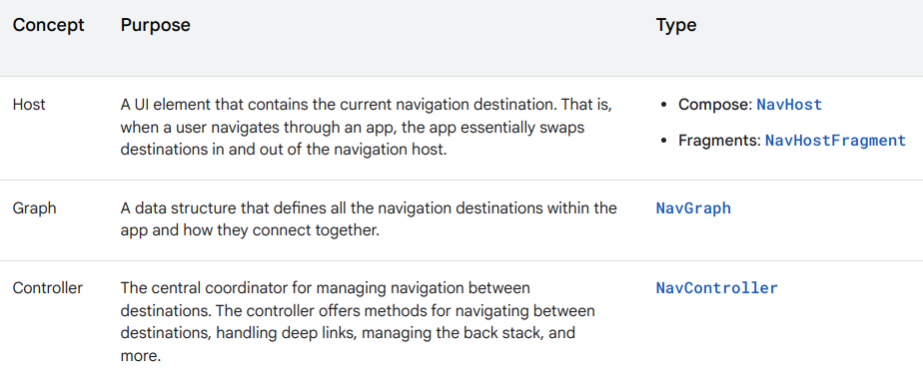
Navigation
Navigation refers to the interactions that let users navigate across, into, and back out from the different pieces of content within your app.
The following table provides an overview of the three key concepts in navigation and the main types that you use to implement them.

Slide 15
Benefits and features
Animations and transitions: Provides standardized resources for animations and transitions.
Deep linking: Implements and handles deep links that take the user directly to a destination.
UI patterns: Supports patterns such as navigation drawers and bottom navigation with minimal additional work.
Type safety: Includes the Safe Args Gradle plugin which provides type safety when navigating and passing data between destinations.
ViewModel support: Enables scoping a ViewModel to a navigation graph to share UI-related data between the graph's destinations.
Fragment transactions: Fully supports and handles fragment transactions.
Back and up: Handles back and up actions correctly by default.

Slide 16
Overview of Navigation
The Navigation Component consists of three key parts, working together in harmony. They are:
Navigation Graph (New XML resource) - This is a resource that contains all navigation-related information in one centralized location. This includes all the places in your app, known as destinations, and possible paths a user could take through your app.
NavHostFragment (Layout XML view) - This is a special widget you add to your layout. It displays different destinations from your Navigation Graph.
NavController (Kotlin/Java object) - This is an object that keeps track of the current position within the navigation graph. It orchestrates swapping destination content in the NavHostFragment as you move through a navigation graph.

Slide 17
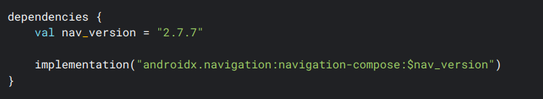
Step 1 - Navigation with Compose
The Navigation component provides support for Jetpack Compose applications. We can navigate between composables while taking advantage of the Navigation component's infrastructure and features.
Setup
To support Compose, use the following dependency in your app module's build.gradle file:

Slide 18

Step 2 - Create NavController
We can create a NavController by using the rememberNavController() method in your main composable:

Slide 19
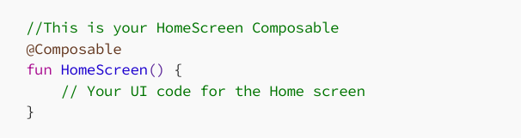
Step 3 – Create Composables
For each destination, create a corresponding composable that represents the UI of that screen. For example, for “home” destination, create HomeScreen() composable.

Slide 20
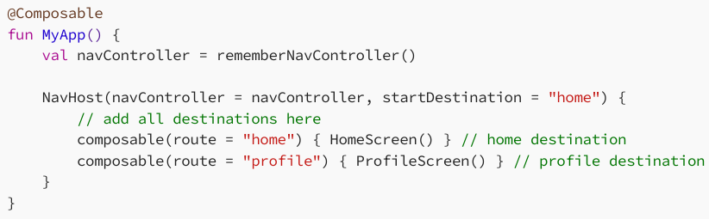
Step 4 - Create NavHost
In the content, you can define all the different destinations of your app.
In your main composables, create a NavHost composable.

Slide 21
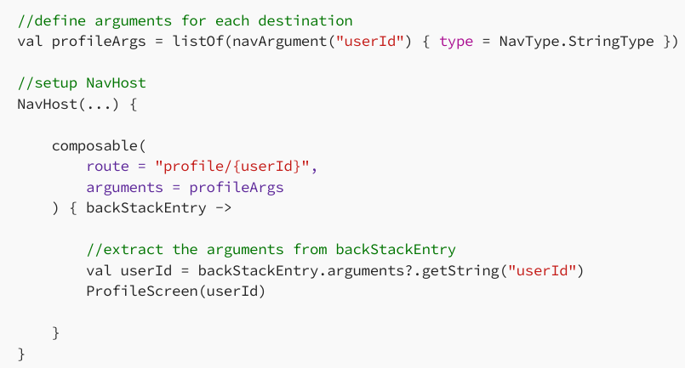

Step 5 - Handling Navigation
How to navigate to particular screen? To navigate from one destination to another, use the navigate method provided by the NavController with or without args.

Slide 22
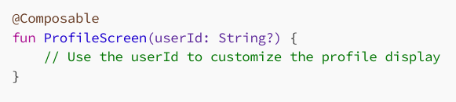
Receive Arguments
In the ProfileScreen composable, you can receive and use the arguments:

